Slide 1
Help – Hilfe zur Selbsthilfe e.V. , German NGO established in 1981

Slide 2
Office in Podgorica, Montenegro opened in April 1999

Slide 3
In 2003, shift from only humanitarian - relief to more development oriented programs: infrastructure, housing and income generation activities

Slide 4
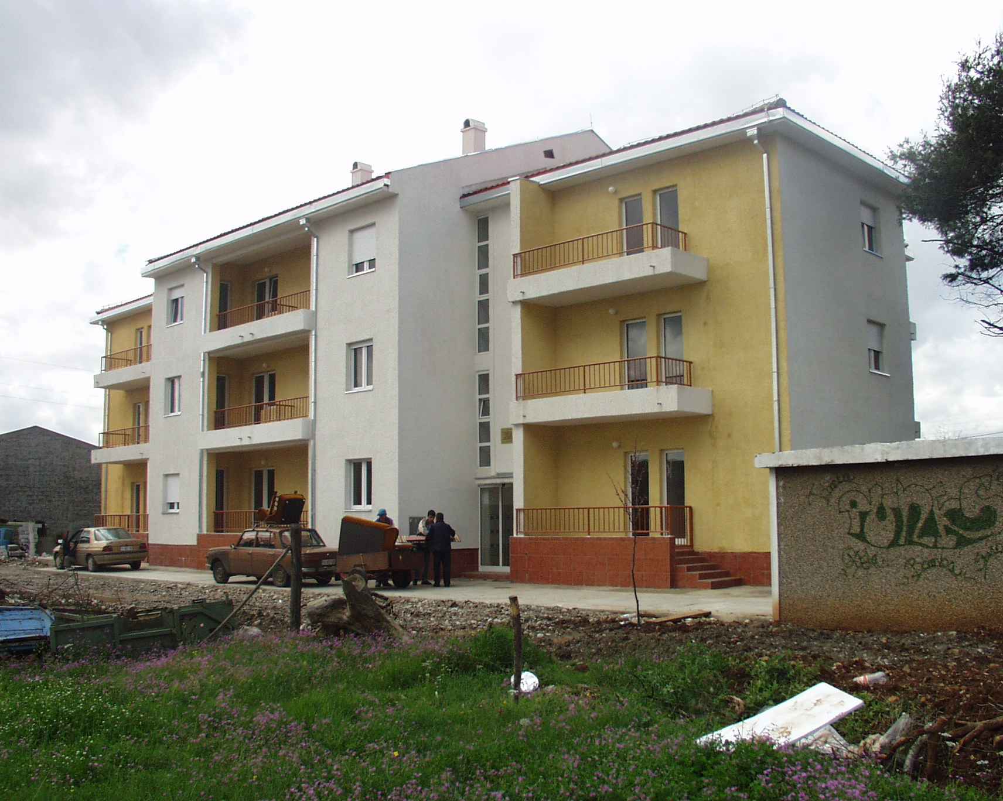
German house 1, Podgorica for refugees from BiH and Croatia. Funded by the German Foreign Ministry

Slide 5
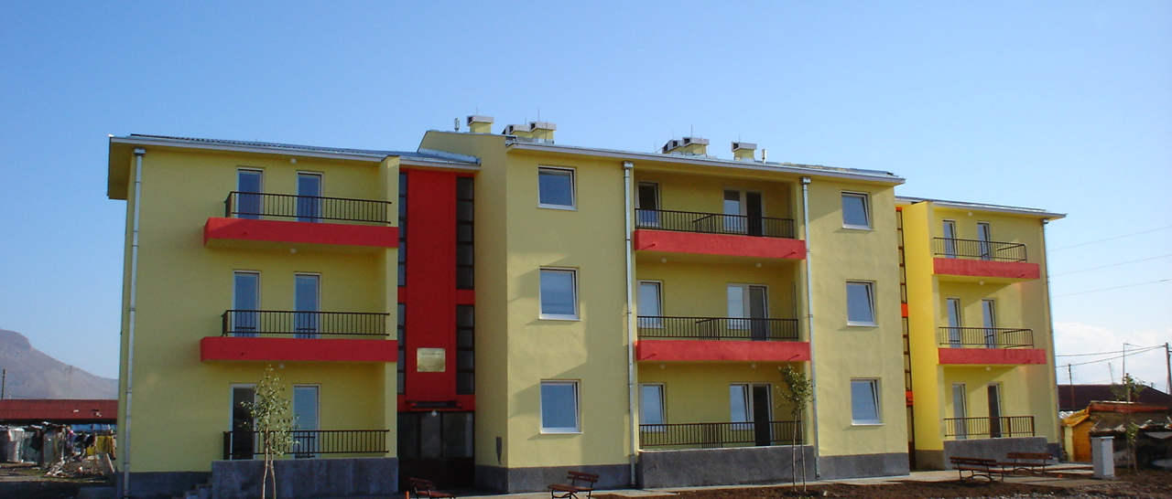
German House 2 in Konik - Podgorica, for RE internally displaced persons from Kosovo. Funded by the German Foreign Ministry

Slide 6
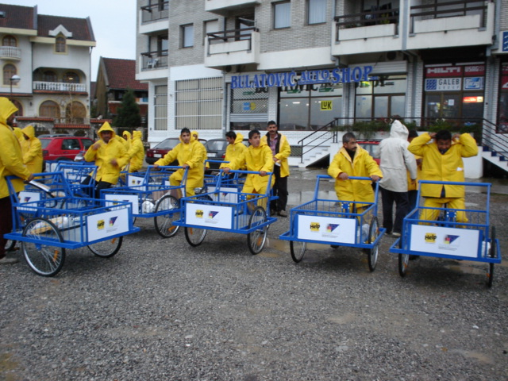
Complementary measures for livelihood enhancement – income generation activities;

Slide 7
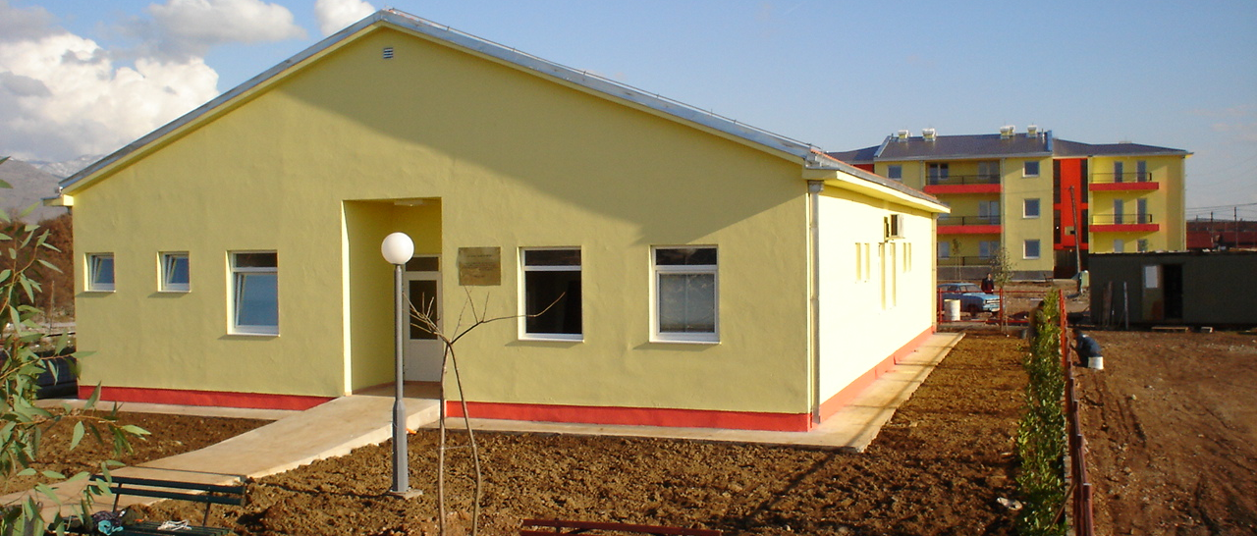
Kindergarten in Konik, Podgorica. Funded by the German Foreign Ministry

Slide 8
Other housing project for Roma and Egyptians:
- Riverside, Berane – 27 house funded by the EU
- Trlica, Pljevlja - 10 houses funded by the German Foreign Ministry
- Zvjerinjak, Nikšić – German Foreign Ministry, UNHCR, Municipality of Niksic, Government of Montenegro

Slide 9
Support to integration and voluntary return of RE and other displaced persons living in Konik area, an EU funded project

Slide 10
Employment component:
- paid internships
- income generation grants
- women’s workshops for production of jewelry

Slide 11
Regional Housing Program
120 apartments in Konik
660 persons
Donor Conference in Sarajevo April 2012

